Slide 1
Do enhancer-associated intergenic long noncoding RNAs contribute to nuclear architecture ?
Cyril Matthey-Doret
Supervised by : Jennifer Yihong Tan
Directed by : Ana Claudia Marques

Slide 2
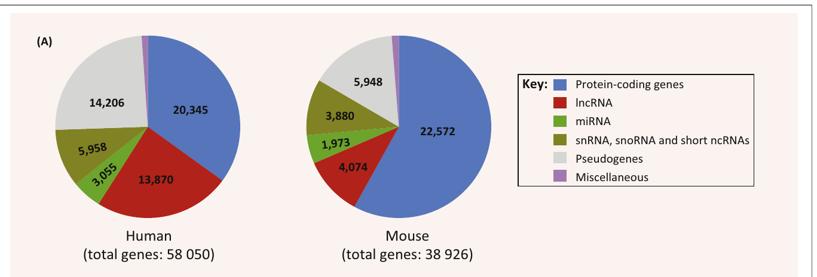
LncRNAs
Long noncoding RNAs
Defined based on length : >200bp
Largest class of noncoding transcript in the human genome
Atianand MK, Fitzgerald KA, 2014. Trends Mol Med.

Slide 3
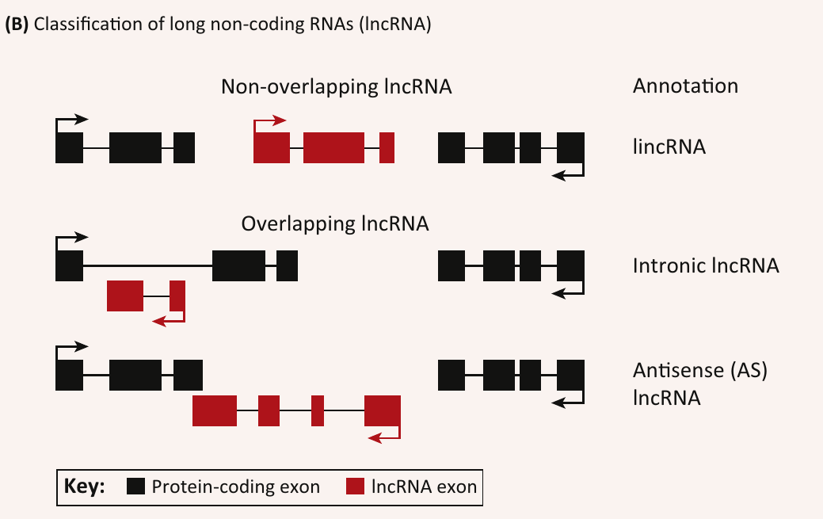
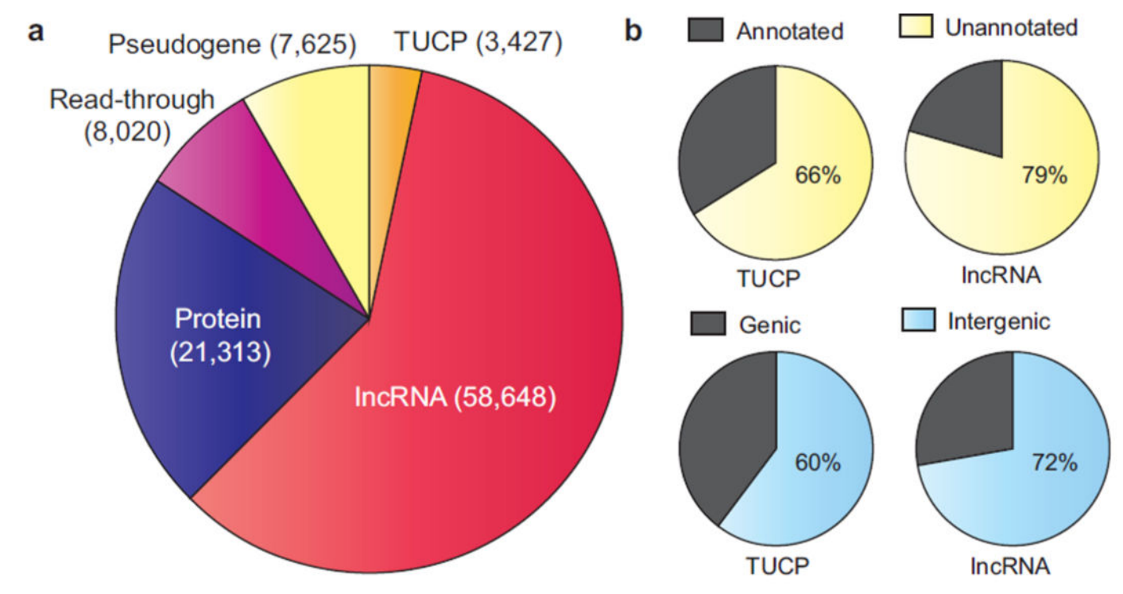
LincRNAs
Long intergenic noncoding RNAs
Do not overlap protein coding genes
Iyer MK et al., 2015. Nat Genet.
Atianand MK, Fitzgerald KA, 2014. Trends Mol Med

Slide 4
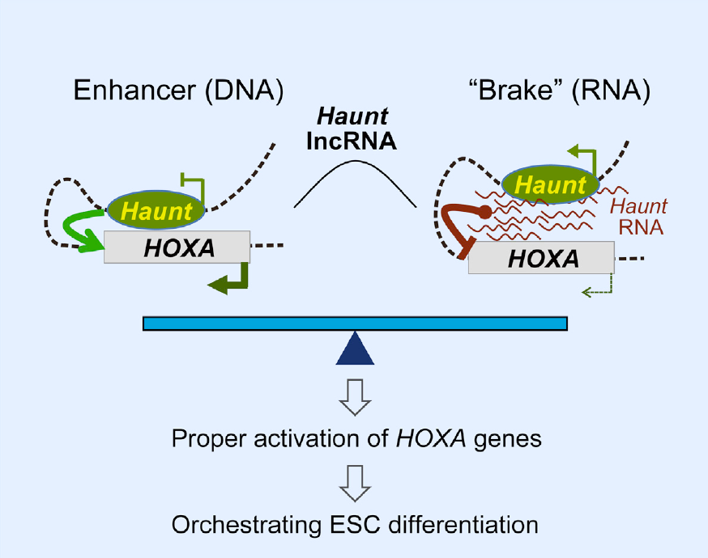
Examples of spatial genome regulation by lincRNAs
Some lincRNAs known to affect chromosomal looping
Other lincRNA involved in large-scale nuclear reorganization (e.g. X-chromsome inactivation)
Yin Y et al., 2015 Cell Stem Cell.

Slide 5
Human trait related lincRNAs
Previous results in the Marques group
Trait-related lincRNAs are associated with :
regions of higher DNA-DNA contacts
Regions with enhancer-like signatures
Do lincRNAs arising from enhancers have a role in the regulation of DNA-DNA contacts ?

Slide 6
Addressing the question
Defining enhancer-associated lincRNAs (elincRNAs)
Testing if elincRNAs in particular are associated with DNA-DNA contacts

Slide 7
ElincRNAs : Definition
Promoter region overlapping enhancers
Definitions based on regulatory elements in GM12878 LCL.
Comparison with « other lincRNAs »
Class | Overlap | Number
elinc | Enhancers only | 236
plinc | Promoters only | 480
other | none | 1756

Slide 8
ElincRNAs and DNA-DNA contacts
How is the genome organized in space ?
How does one measure DNA-DNA contacts ?
How do these DNA-DNA contact relate to elincRNAs ?

Slide 9
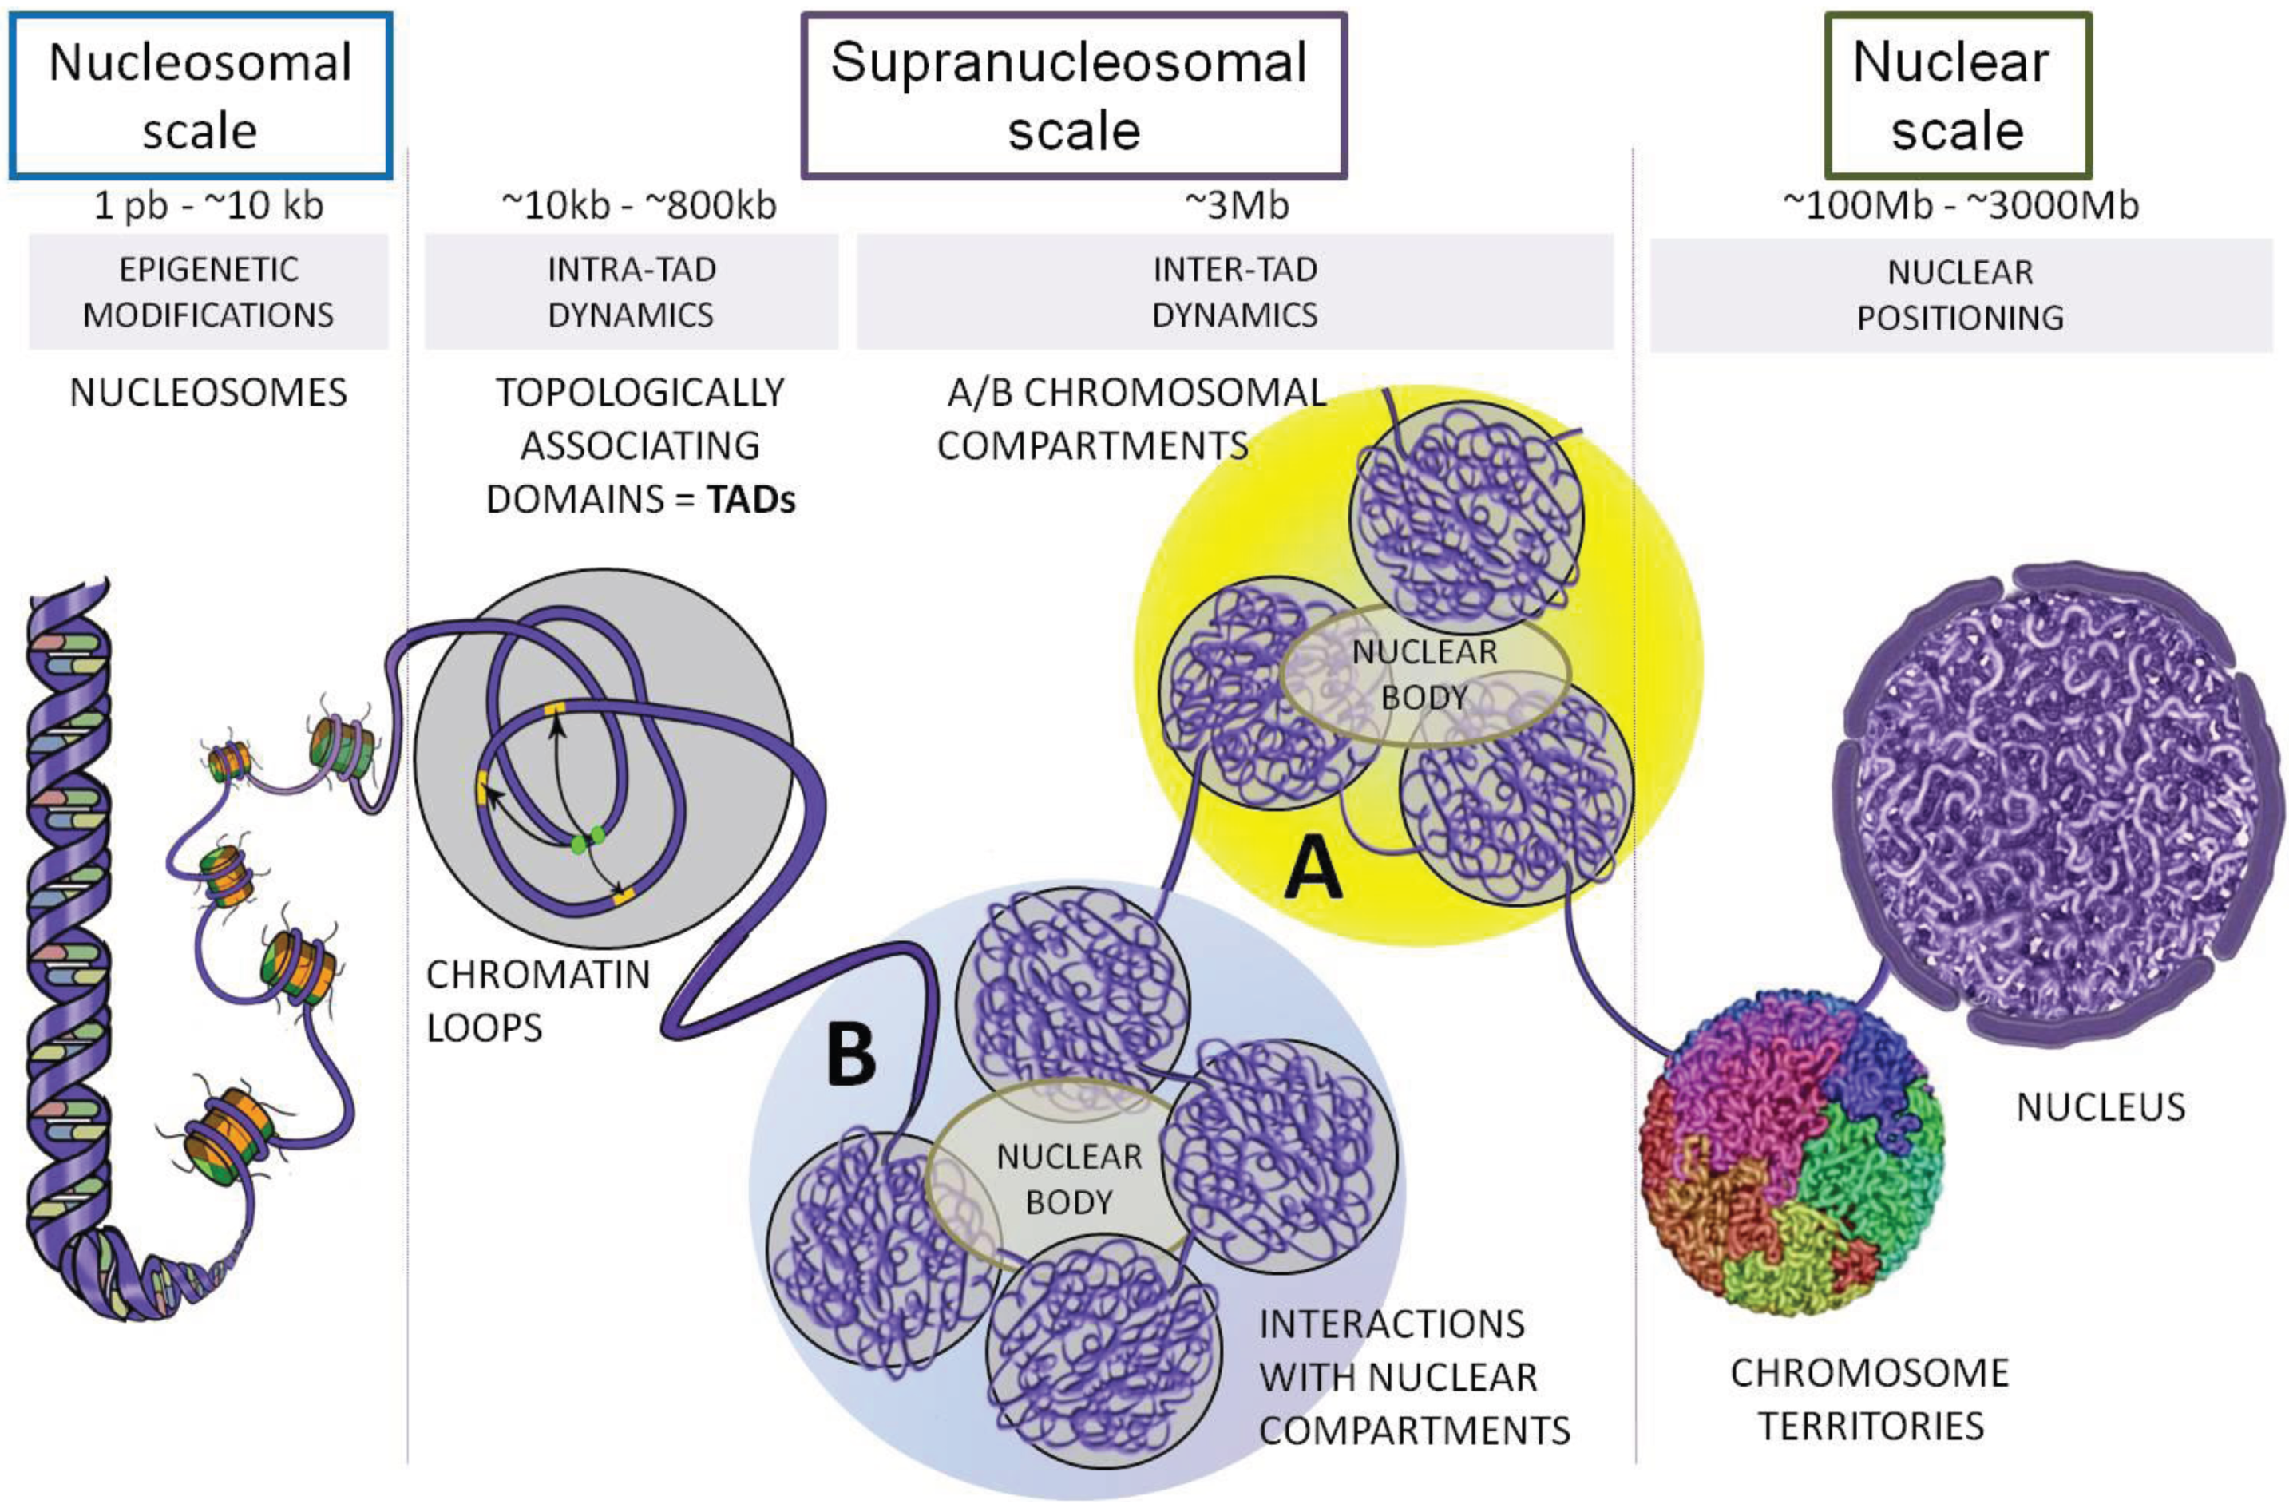
The 3D genome
The genome is folded into compact structures
Ea V et al, 2015. Genes

Slide 10
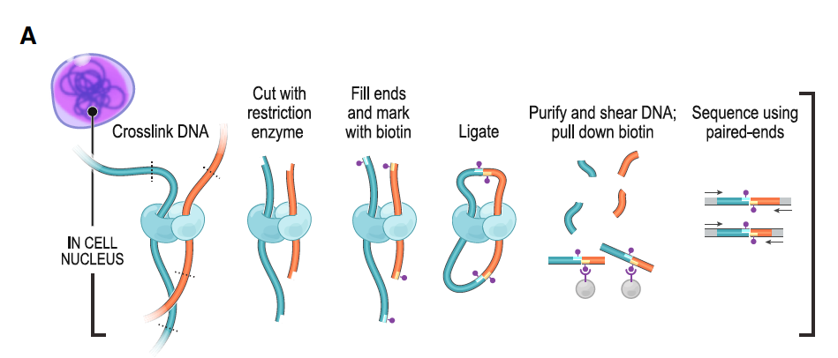
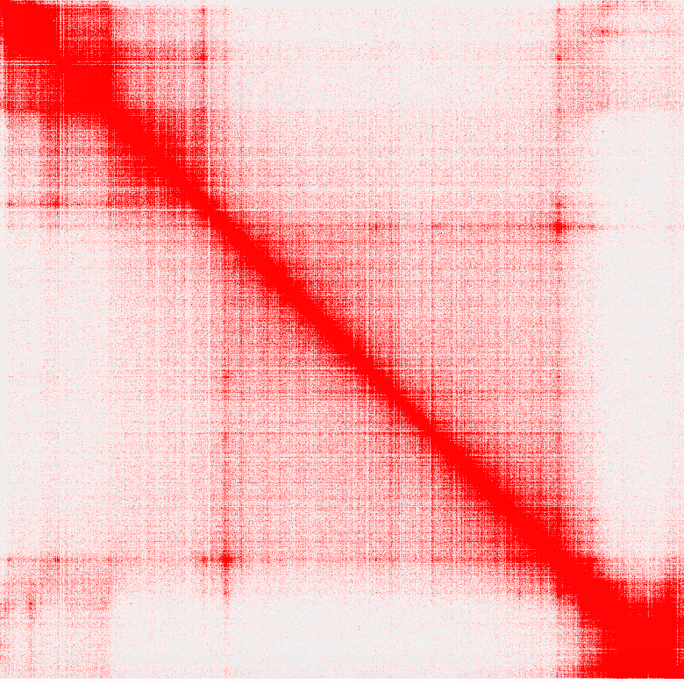
Hi-C technology
Genome-wide chromosome conformation capture
Allows to map all interactions in the genome up to 5kb resolution
Rao et al, 2014. Cell

Slide 11
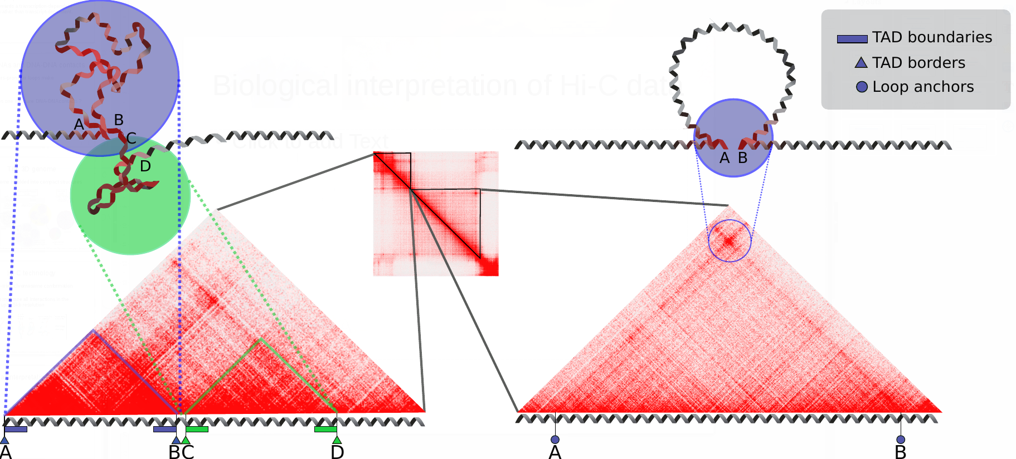
Biological interpretation of Hi-C data
TADs and loops show distinct patterns

Slide 12
TAD boundaries
Regions around the borders of TADs
Promote intra-TAD contacts and prevent inter-TAD contacts
Enriched in insulator proteins CTCF and cohesin
Defined as areas with low interactions across them, extending inside TADs from borders

Slide 13
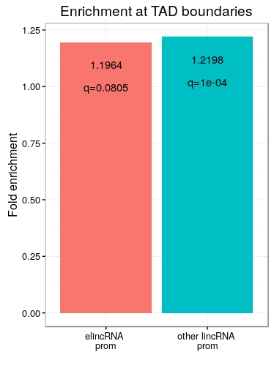
ElincRNAs are not enriched at TAD boundaries
elincRNAs are not enriched at custom-defined TAD boundaries compared to other lincRNAs.
Both are slightly enriched at
boundaries.
q : p-value adjusted for multiple testing

Slide 14
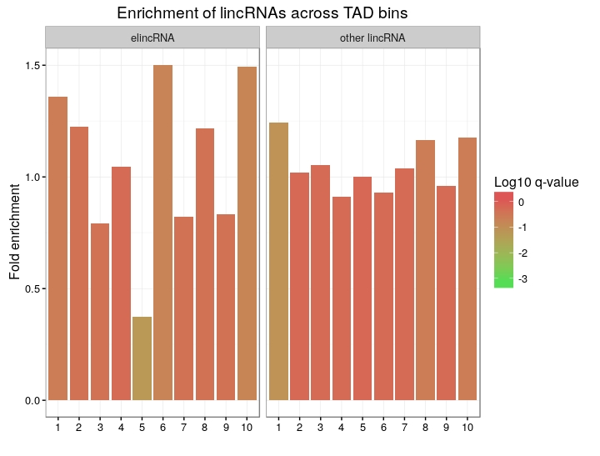
ElincRNAs are not enriched at TAD boundaries
Double check with a more simple approach
Dividing TADs into 10 equally-sized bins.
No significant enrichment, but there is a trend.

Slide 15
ElincRNAs are not enriched at TAD boundaries
Double check with a more simple approach
Dividing TADs into 10 equally-sized bins.
No significant enrichment, but there is a trend.
Strong depletion at the center
0.37 fold, q=0.055

Slide 16
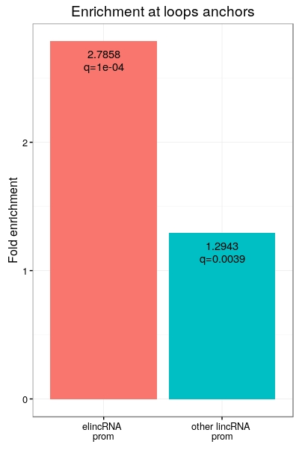
ElincRNAs are enriched at loop anchors
Promoter regions of elincRNAs are strongly enriched at loop anchors compared to other lincRNAs
Supporting association between
elincRNAs and loop formation ?

Slide 17
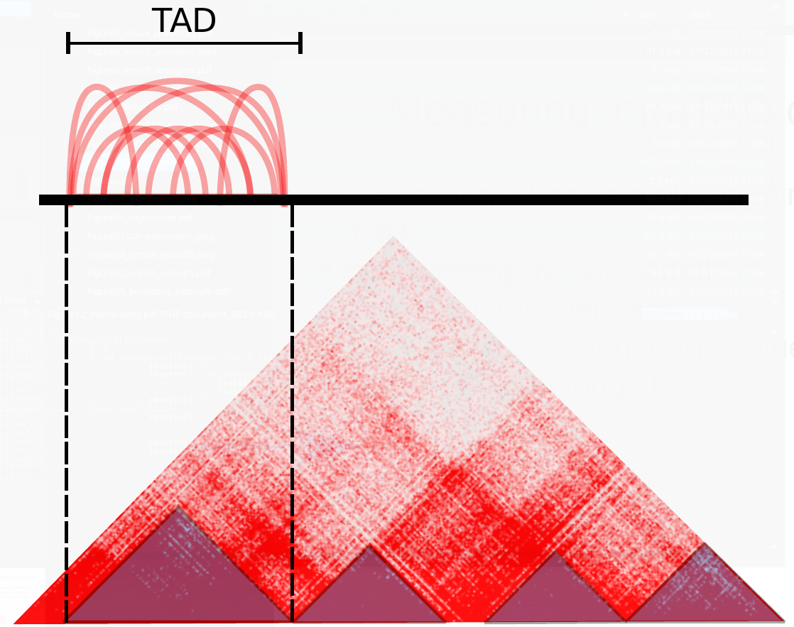
Measuring intraTAD contacts
Measuring all contacts happening inside very TAD.
Normalizing by TAD length (mean contact per 5kb).
Each gene is assigned the value of the TAD it belongs to.

Slide 18
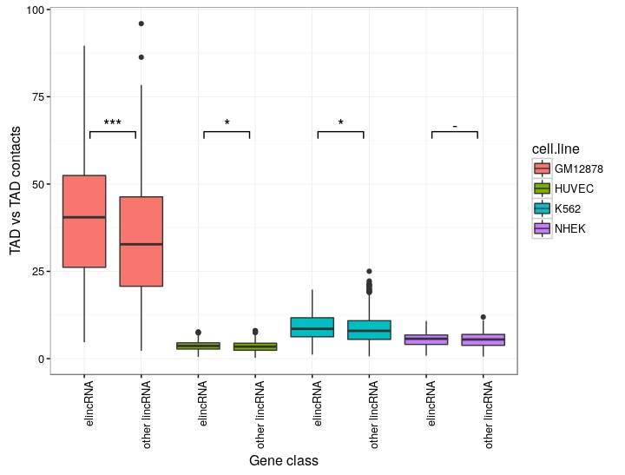
ElincRNAs belong to higher contact TADs
ElincRNAs are associated with higher DNA-DNA contacts TADs than other lincRNAs
Transcription of elincRNAs promoting TAD compaction ?

Slide 19
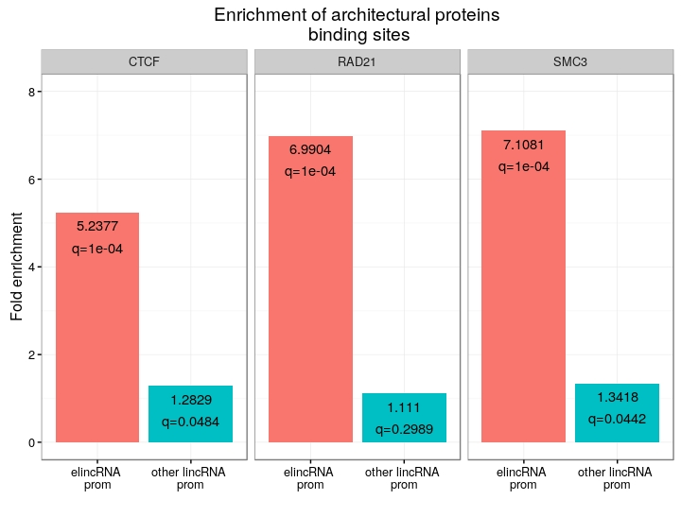
ElincRNAs enriched in insulator proteins
CTCF and cohesin (RAD21 and SMC3) are enriched in elincRNAs promoter regions compared to other lincRNAs.

Slide 20
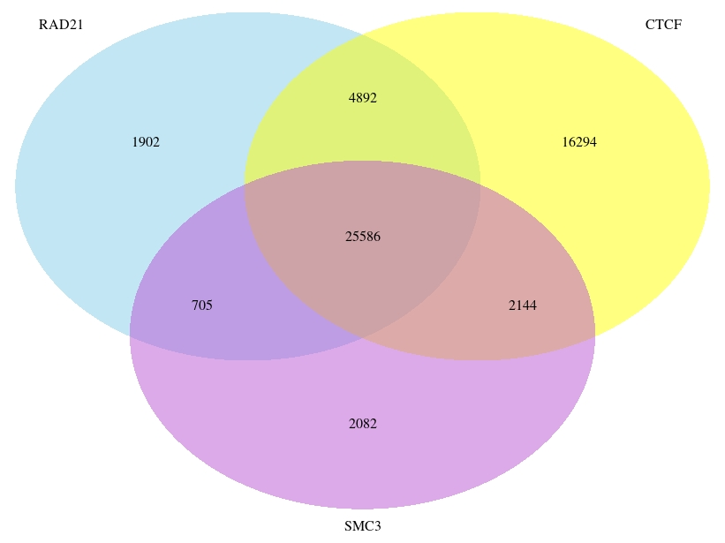
CTCF and cohesin peaks overlap
CTCF and cohesin peak regions largely overlap
Is the enrichment still present at CTCF-only peaks ?

Slide 21
CTCF and cohesin peaks overlap
CTCF and cohesin peak regions largely overlap
Is the enrichment still present at CTCF-only peaks ?

Slide 22
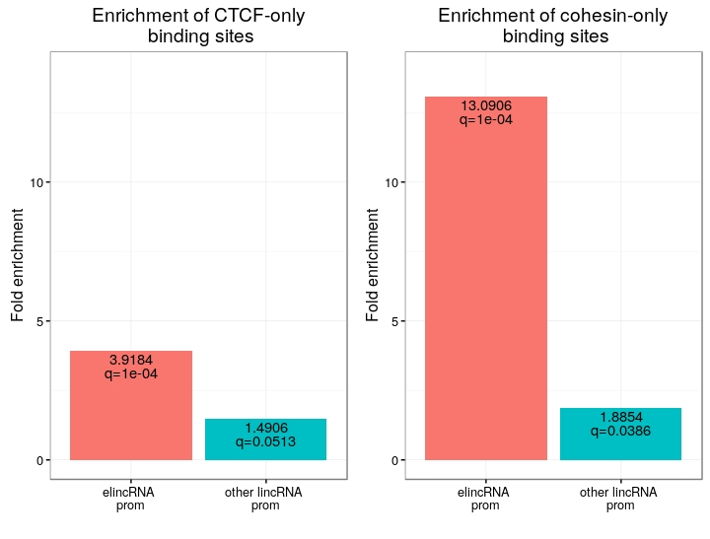
ElincRNAs strongly enriched in cohesin-only peaks
The promoter regions of elincRNAs show a very strong enrichment for cohesin exclusive peaks compared to other lincRNAs
This is not the case
for CTCF peaks

Slide 23
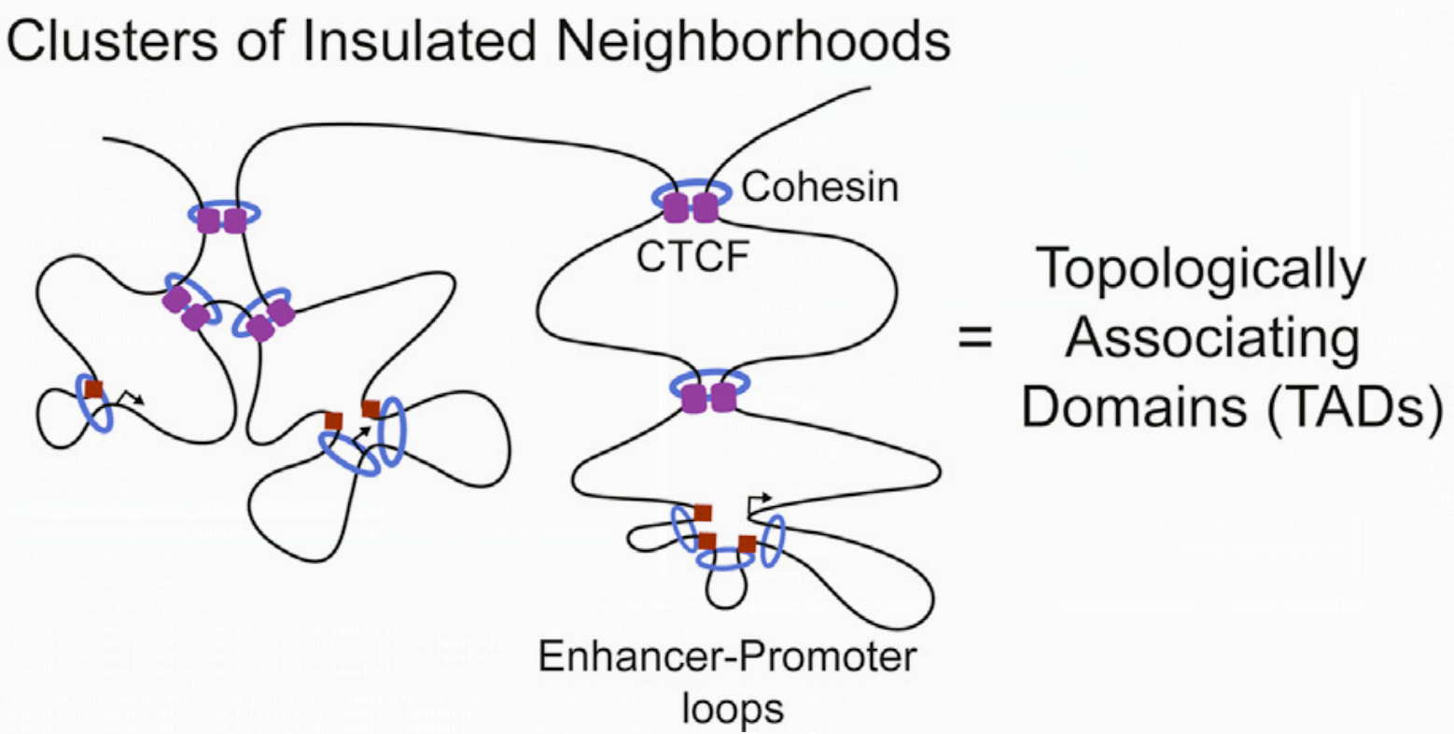
CTCF/cohesin roles in TADs
A new model for CTCF/cohesin loops in TADs was recently proposed
CTCF/cohesin loops are important for structural maintenance of TADs
Cohesin-only loops are smaller promoter-enhancer loops
Ji X et al., 2016. Cell Stem Cell

Slide 24
Conclusions
ElincRNAs are enriched at loop anchors, but not significantly at TAD boundaries
Likely not involved in the maintenance of TAD boundaries
They are enriched in cohesin compared to other lincRNAs
Could be involved in enhancer-promoter looping
They are associated with TADs presenting more compaction
Could promoter these enhancer-promoter loops

Slide 25
Outlook
Comparing enhancers producing elincRNAs vs those that do not would be more meaningful
Extending the analysis to other cell-lines may reveal interesting patterns

Slide 26
Questions ?

Slide 27
Discussion
Ongoing debate : Transcript- or transcription-mediated functions of eRNAs in general
The mechanistic functions (if any) of spatial regulation by elincRNAs are probably case specific
Analysis is limited by the resolution of the technology
Only looking at intra-chromosomal contact. Interchromosomal and lamina contact might add interesting information

Slide 28
Supplementary slides

Slide 29
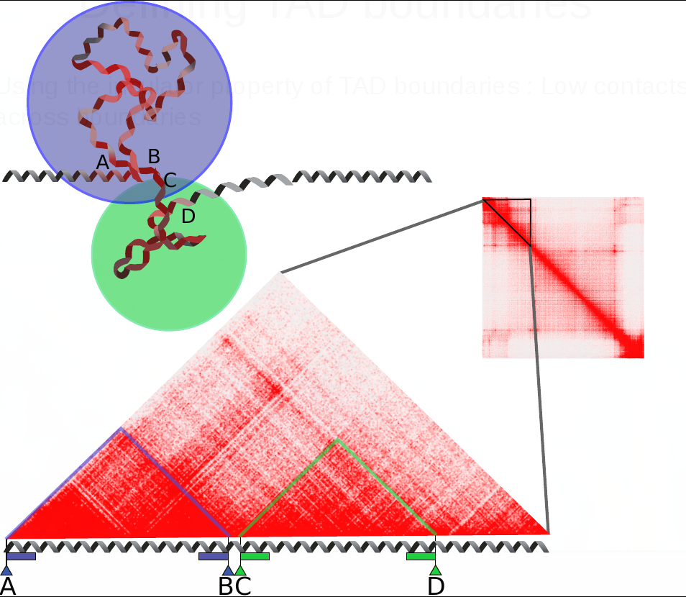
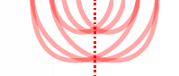
Defining TAD boundaries
Using the insulator property of TAD boundaries : Low contacts across boundaries
Extending boundaries inwards only (technical limitation)
Stop extending when the contacts reach a threshold

Slide 30
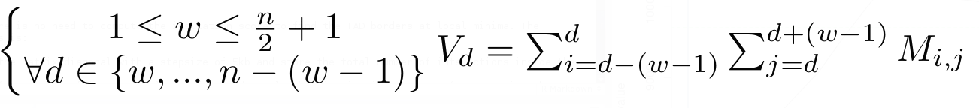
Defining TAD boundaries
Compute contacts across every position « d » in the genome at a maximum range of « w ».
Diamond of width « w » slides along the diagonal.
w : arbitrary threshold set to 100kb
V : measure of insulation for every position along the diagonal
1
n

Slide 31
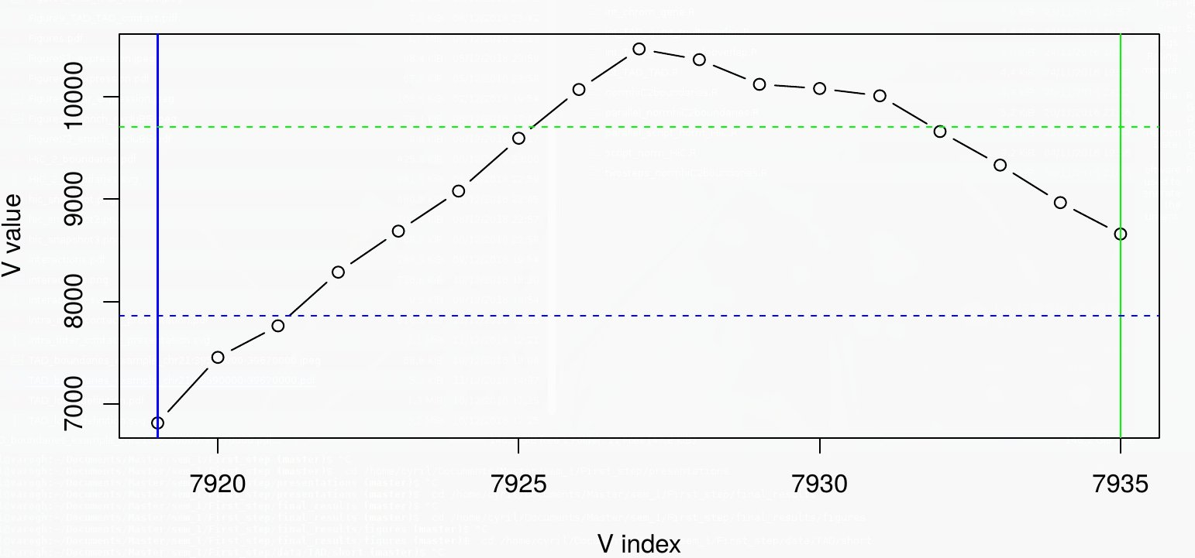
Defining TAD boundaries
For every TAD, boundaries are extended inwards from the borders until the value of V_{d} reaches a defined threshold.

